Slide 1
A Survey on Beyond 5G Network Slicing for Smart Cities Applications
IEEE Communications Survey & Tutorials – Feb 2025
Wajid Rafique , Joyeeta Rani Barai , Abraham O. Fapojuwo , Diwakar Krishnamurthy
Presenter – Divya K.

Slide 2
abstract
A comprehensive survey on B5G network slicing use cases, practical implementations, and applications
Provides detailed taxonomy of B5G network slicing framework requirements, design, dynamic intra- and inter-slice resource allocation techniques, management, and orchestration
Discusses technical challenges for implementing B5G network slicing for smart cities applications and potential solutions

Slide 3
Introduction
B5G Smart Cities Vision
Smart cities will evolve into data-driven ecosystems with dense IoT deployments, autonomous vehicles, remote healthcare, and smart infrastructure.
B5G will enable:
Ultra-reliable, low-latency communications (URLLC)
High throughput and massive device connectivity
Real-time service delivery and data analytics
Key architectural goals include AI-native orchestration, secure virtual slices, and autonomous adaptation to traffic and user demands.

Slide 4
Introduction
Smart Cities B5G Network Slicing Enablers
Software-Defined Networking (SDN): Separates control and data planes for centralized management.
Network Function Virtualization (NFV): Enables dynamic deployment of virtual network functions (VNFs).
Multi-access Edge Computing (MEC): Reduces latency by moving computing closer to users.
Together, these enable programmable, scalable, and service-specific network slices.

Slide 5
B5G Smart Cities Applications and Requirements
Smart Cities QoS Requirements for 5G, B5G, and 6G
Each generation enhances support for diverse services:
5G: eMBB, URLLC, mMTC with rigid QoS classes.
B5G/6G: Hybrid, customizable QoS profiles.
Future networks must support deterministic delay, ultra-high reliability, and service-based SLAs.

Slide 6
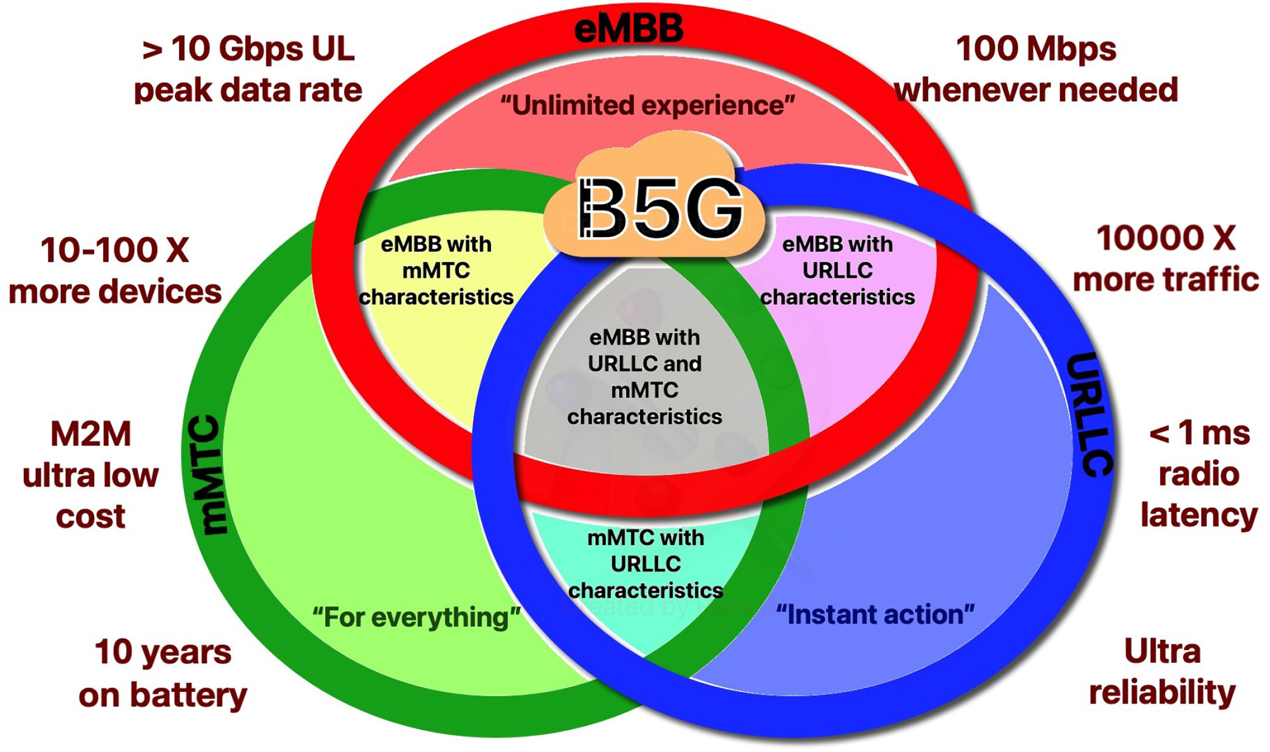
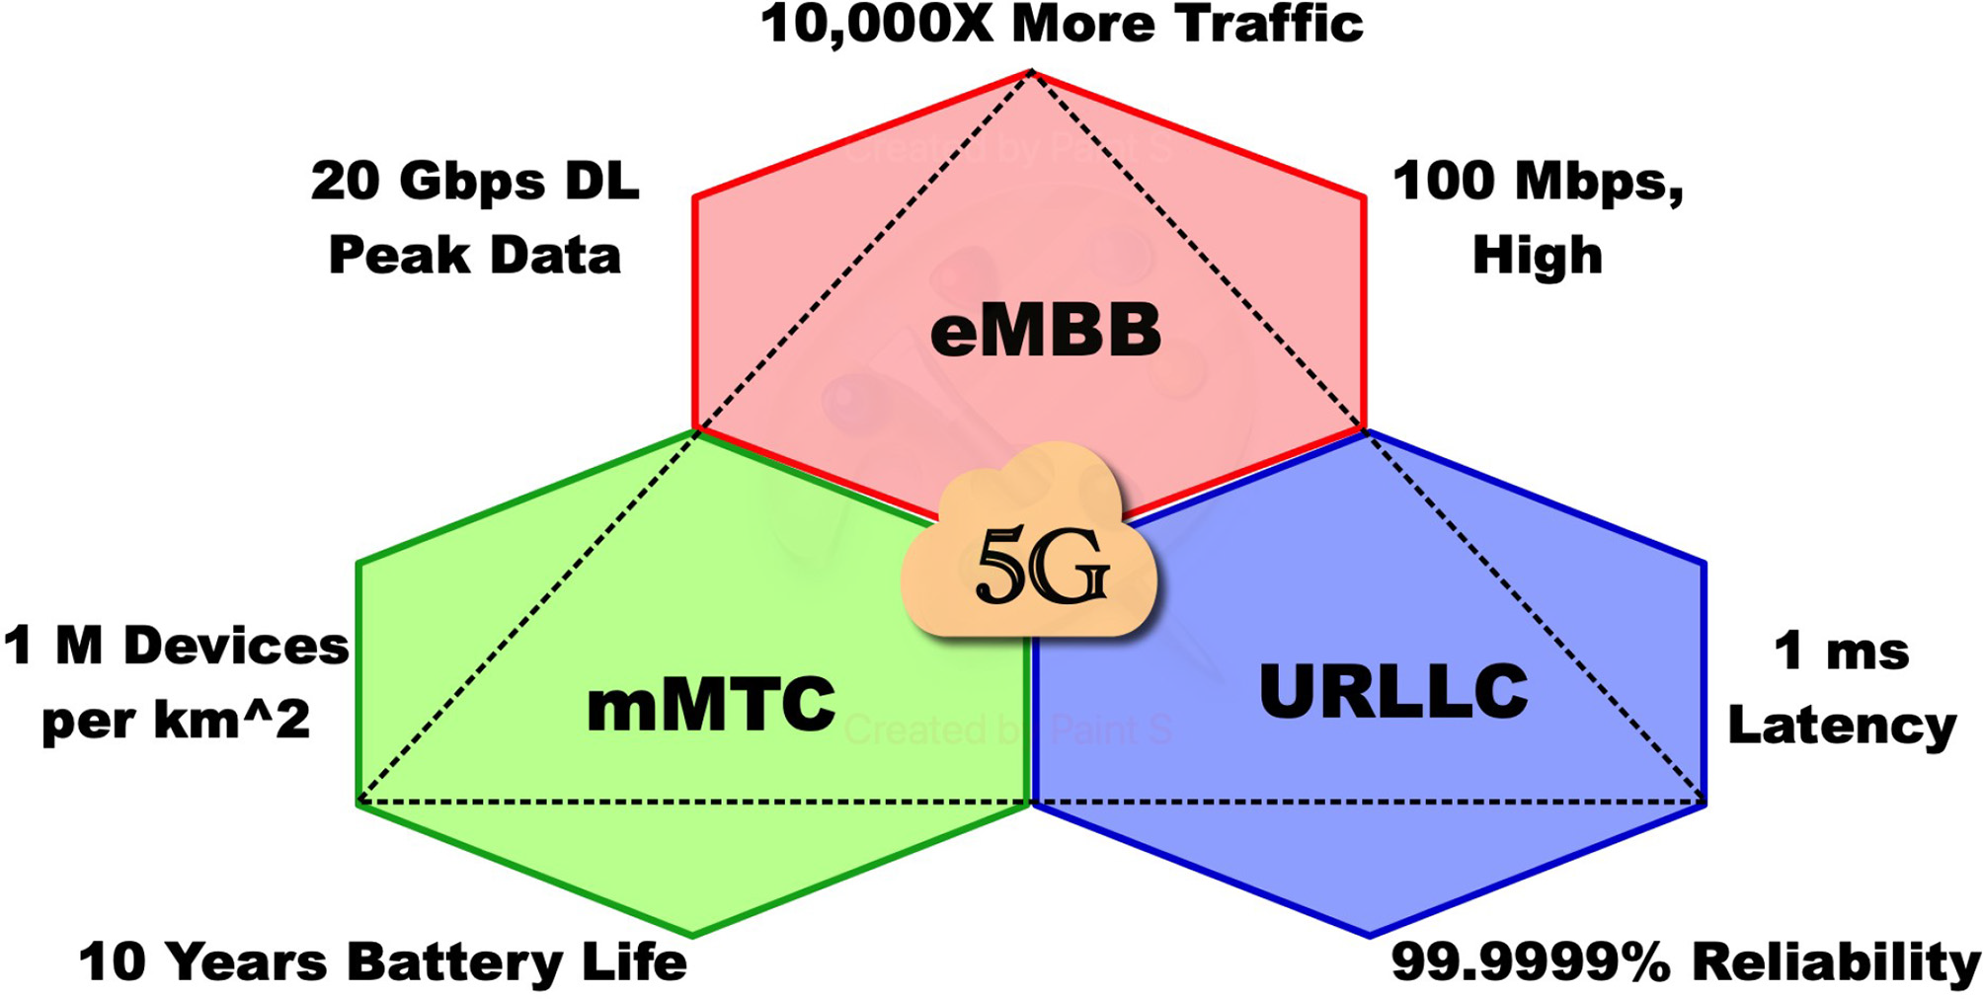
B5G Smart Cities Applications and Requirements
5G three main service categories
5G and B5G service categories

Slide 7
B5G Smart Cities Applications and Requirements
Emergency Response
Requires ultra-reliable, low-latency connectivity (URLLC).
Traffic type: Deterministic Aperiodic Traffic (DAT).
Examples:
5G-connected ambulances.
Smart patrol cars with real-time video and biometric streaming.
Services must dynamically scale and isolate resources during crises.

Slide 8
B5G Smart Cities Applications and Requirements
Smart Transportation & Autonomous Vehicles
Traffic: Deterministic Periodic Traffic (DPT).
Requires high bandwidth, low latency, and real-time V2X communication.
Examples include:
Railway signaling systems (e.g., SEPTA in the US).
Smart vehicle dispatch in Detroit.
Slices must support vehicle-to-infrastructure and vehicle-to-cloud interactions.

Slide 9
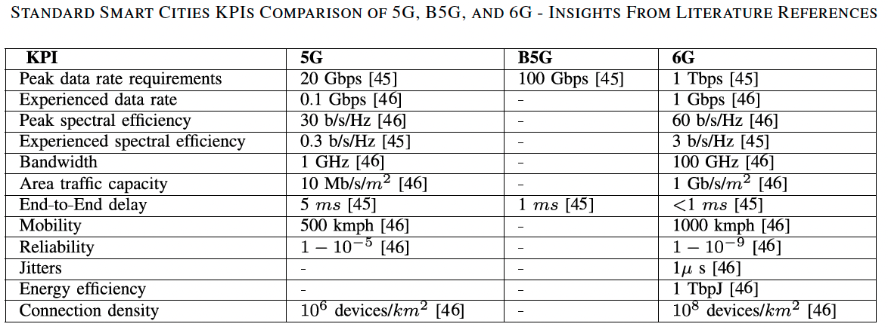
B5G Smart Cities Applications and Requirements

Slide 10
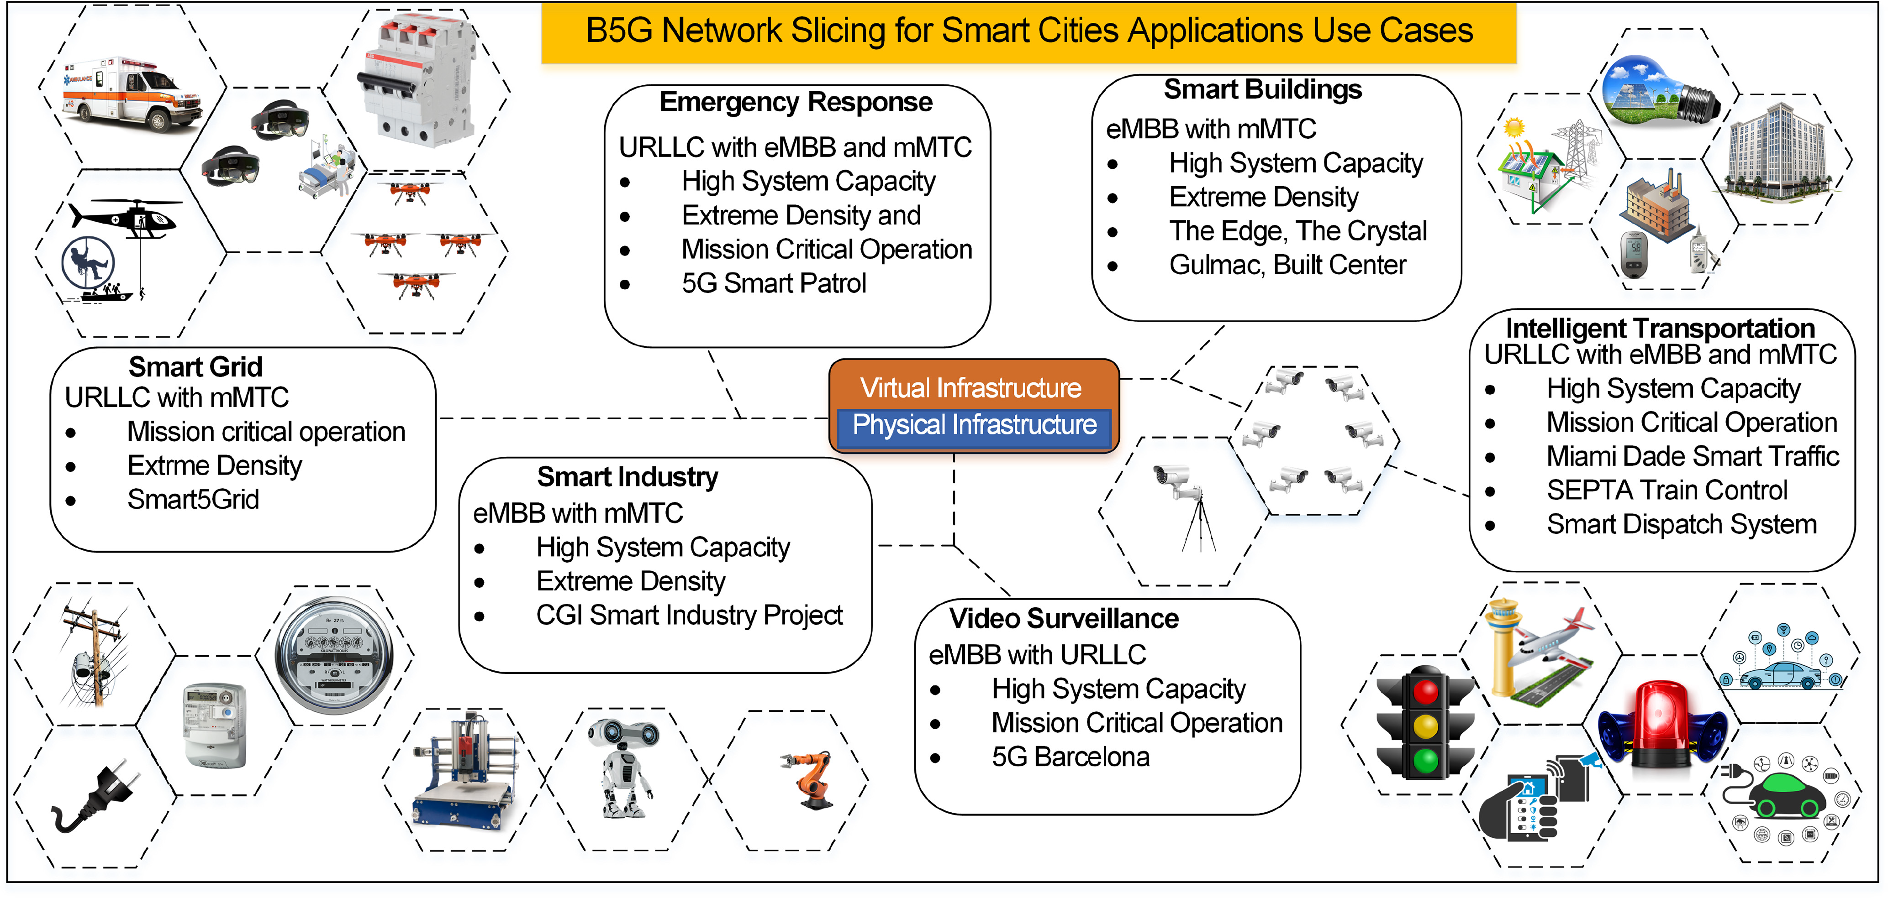
B5G Smart Cities Applications and Requirements

Slide 11
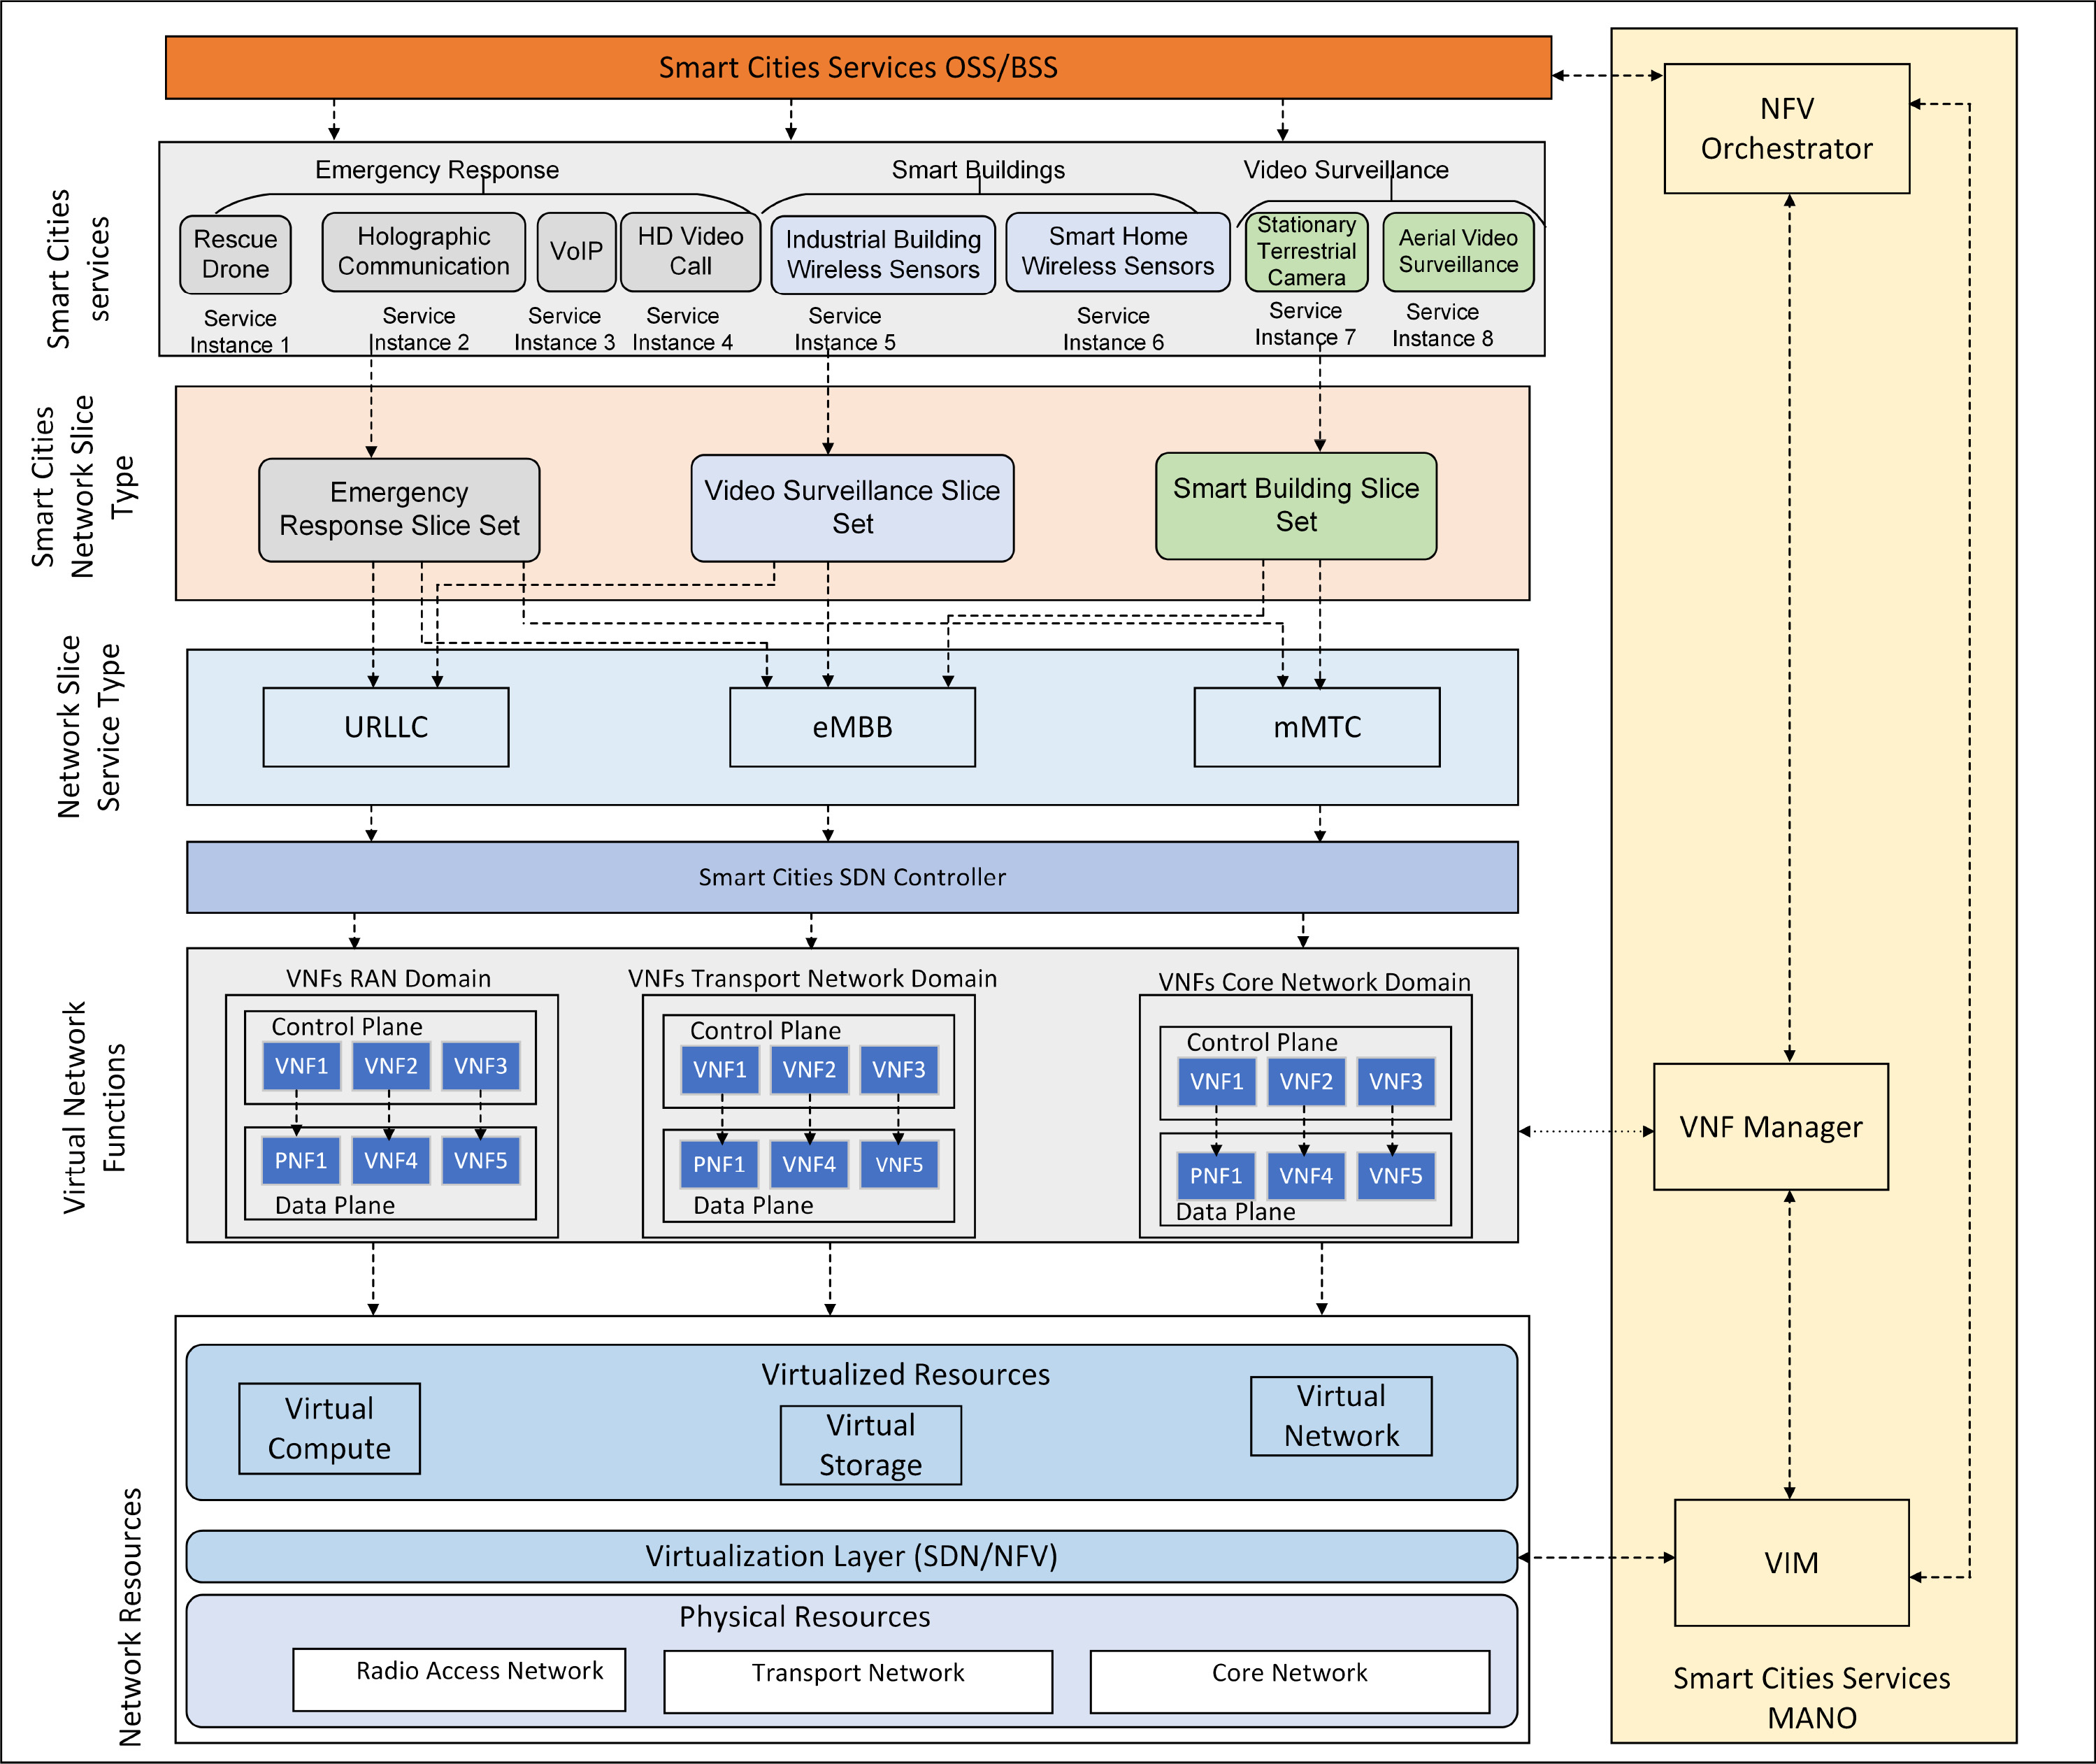

Slide 12
Technical Challenges of B5G Network Slicing for Smart City Applications
Dynamic Network Slicing Challenges
Applications require varied, dynamic slice characteristics.
Slices must be:
Instantiated quickly.
Scaled elastically.
Terminated on demand.
Issues: resource conflict resolution, coordination across domains, and traffic prediction.

Slide 13
Technical Challenges of B5G Network Slicing for Smart City Applications
User Intent-Based Spectrum Slicing and Sharing
Instead of fixed allocations, slices adjust based on user behavior or application needs.
Example: Emergency services receive more bandwidth during disasters.
Challenge: Implementing secure and interpretable intent-based models.

Slide 14
Technical Challenges of B5G Network Slicing for Smart City Applications
Application-Based End-to-End Slice Management and Orchestration (MANO)
Centralized MANO struggles with diverse, cross-domain applications.
Smart cities demand:
Distributed orchestration.
Context-aware slice instantiation.
E.g., Surveillance may require high bandwidth + video processing VNFs at the edge

Slide 15
Technical Challenges of B5G Network Slicing for Smart City Applications
Adaptive End-to-End Network Virtualization
Slices span access, transport, and core networks.
Virtualization must:
Abstract multi-vendor hardware.
Guarantee resource isolation.
Adapt to real-time usage and mobility patterns.

Slide 16
Technical Challenges of B5G Network Slicing for Smart City Applications
Dynamic Service Function Chaining (SFC) for Emergency Response
Emergency scenarios need flexible chains of VNFs like firewalls, video optimizers, and encryption units.
Goal: predefine chains but adapt them to context in real-time.
Example: Use GNNs (graph neural networks) to optimize chaining in changing topologies.

Slide 17
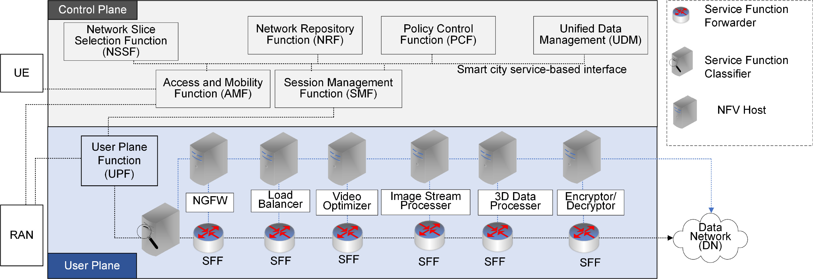
Technical Challenges of B5G Network Slicing for Smart City Applications
Dynamic Service Function Chaining (SFC) for Emergency Response
A service-based architecture of emergency response holographic communication use case showing control plane and user plane functions using B5G network slicing in smart cities

Slide 18
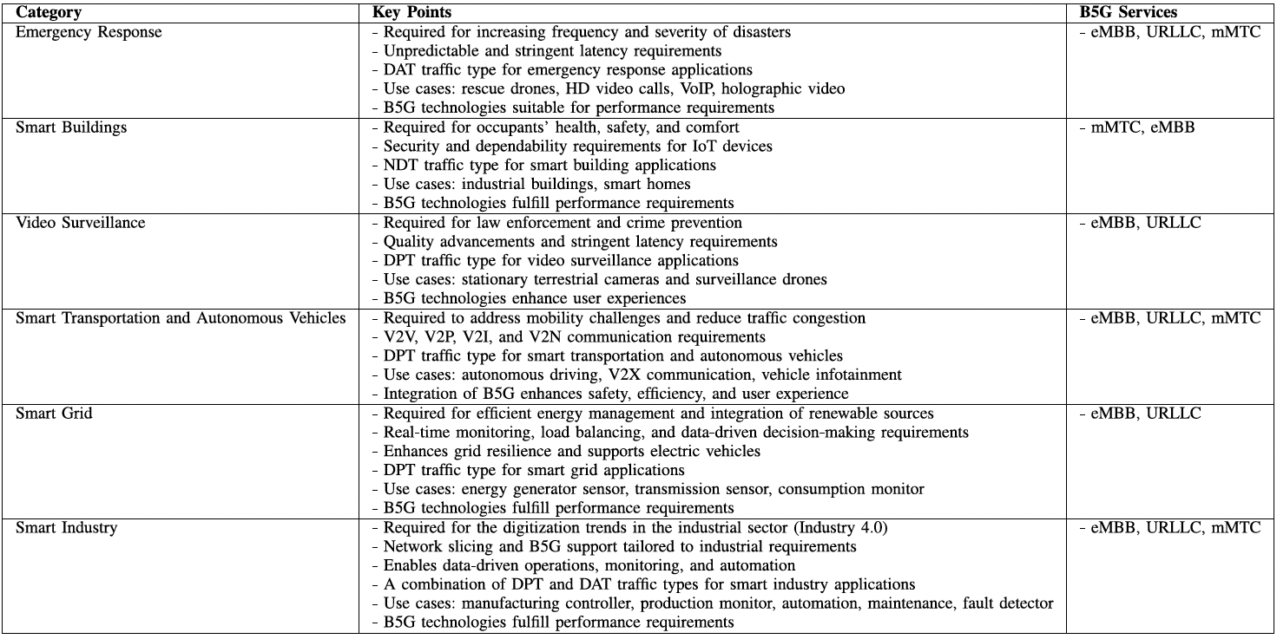

Slide 19
Current and Future Research Directions
Emergency Response Slice Isolation
Dedicated slices ensure no performance degradation during crises.
Requires policies for:
Physical and logical separation.
Priority enforcement.
Secure access control.

Slide 20
Current and Future Research Directions
AI/ML Techniques for Slice Resource Management
Use cases:
Predictive scaling.
Anomaly detection.
Traffic classification.
Techniques:
Reinforcement learning for dynamic scaling.
Supervised learning for SLA violation prediction.

Slide 21
Current and Future Research Directions
Service Guarantee in Healthcare
Key metrics: delay <1 ms, 99.999% reliability.
Telesurgery and remote diagnostics depend on:
E2E QoS assurance.
Fast recovery mechanisms.
Slice orchestration must consider patient location and application criticality.

Slide 22
Current and Future Research Directions
Dynamic Adaptation of ML Models in Smart Cities
Challenge: ML models trained on one dataset may fail on another (data drift).
Solutions:
Online learning.
Meta-learning to generalize across applications.
Federated learning to preserve privacy.

Slide 23
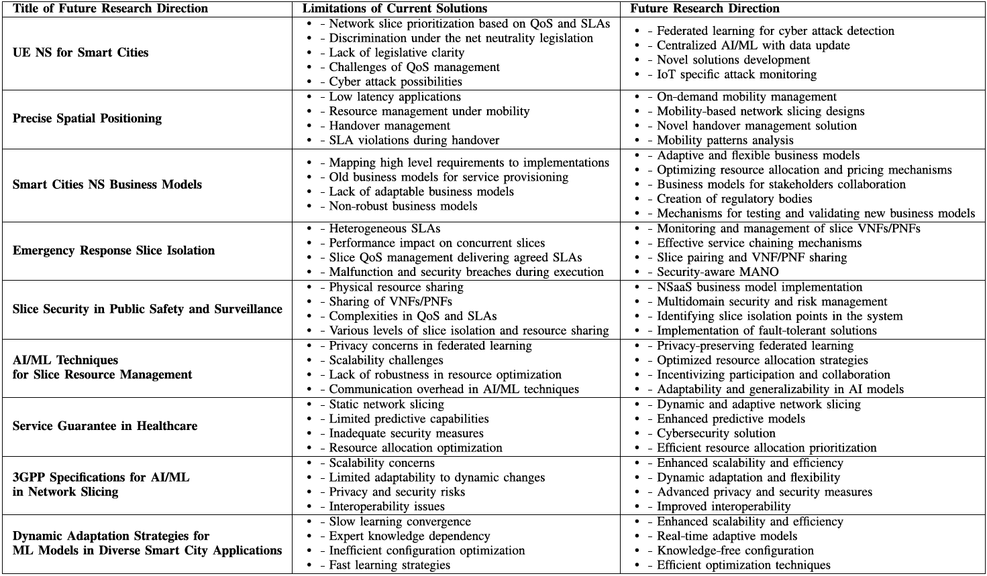

Slide 24
reference
W. Rafique, J. Rani Barai, A. O. Fapojuwo and D. Krishnamurthy, "A Survey on Beyond 5G Network Slicing for Smart Cities Applications," in IEEE Communications Surveys & Tutorials, vol. 27, no. 1, pp. 595-628, Feb. 2025, doi: 10.1109/COMST.2024.3410295. keywords: {Smart cities;5G mobile communication;Network slicing;Surveys;Video surveillance;Network function virtualization;Internet of Things;Beyond 5G network slicing;AI/ML;3GPP;NFV;SDN;smart cities},

